Slide 1
Engineering Interactive Visual Interfaces for Data Science (“The CS Data Vis Class”)
xkcd

Slide 2
March 10, 2025
Engineering Interactive Visual Interfaces for Data Science
“The CS Data Vis Class”
Dr. Jillian Aurisano
Plan for today:
Logistics
Tabular data
Distributions
Part to whole
High-dimensional data
Activity

Slide 3
Project, Assignments
Project 2 is out
Form teams ASAP!
Post your team to the submission on Canvas
Vis in the Wild Assignment is Posted
Details ….
Shortly- Vis Design exploration assignment
Details …

Slide 4
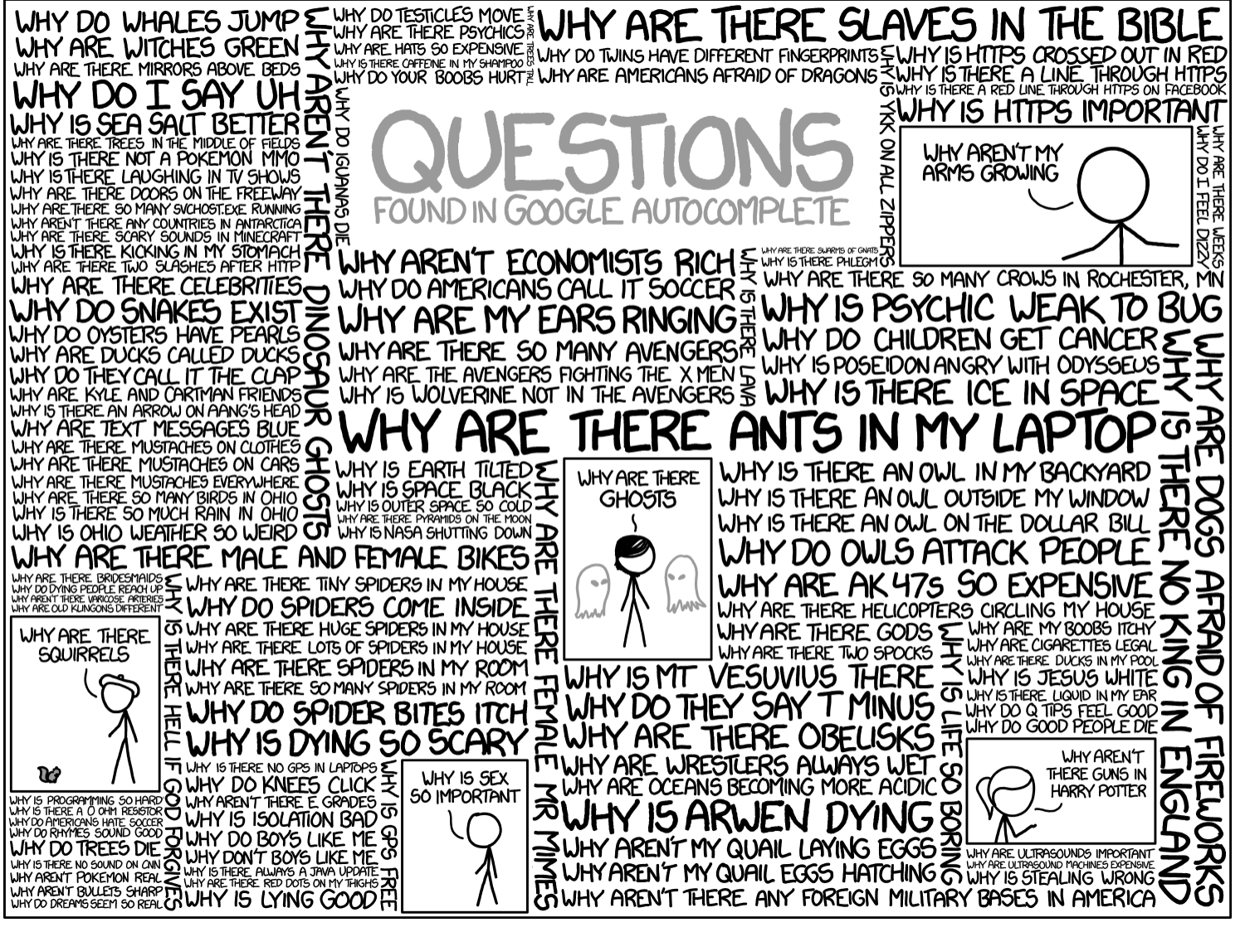
Questions?

Slide 5
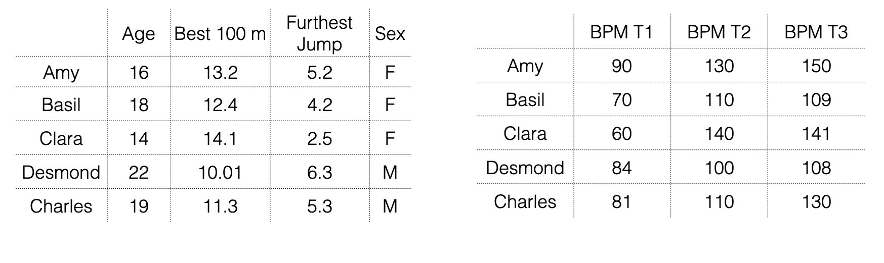
Tables
Tables are one of the most common dataset types
Structure:
Items – independent variables
People, countries, schools
Data Attributes-
Things we observe about the items

Slide 6
Discuss with a partner ways to visualize each table

Slide 7
Same vis for both tables?
What makes them different?

Slide 8
Same vis for both tables?
2 very different tables
Same dimensionality, but
One is heterogenous, data attributes
The other is a set of time stamps
Homogeneity or heterogeneity- impacts the vis approach

Slide 9
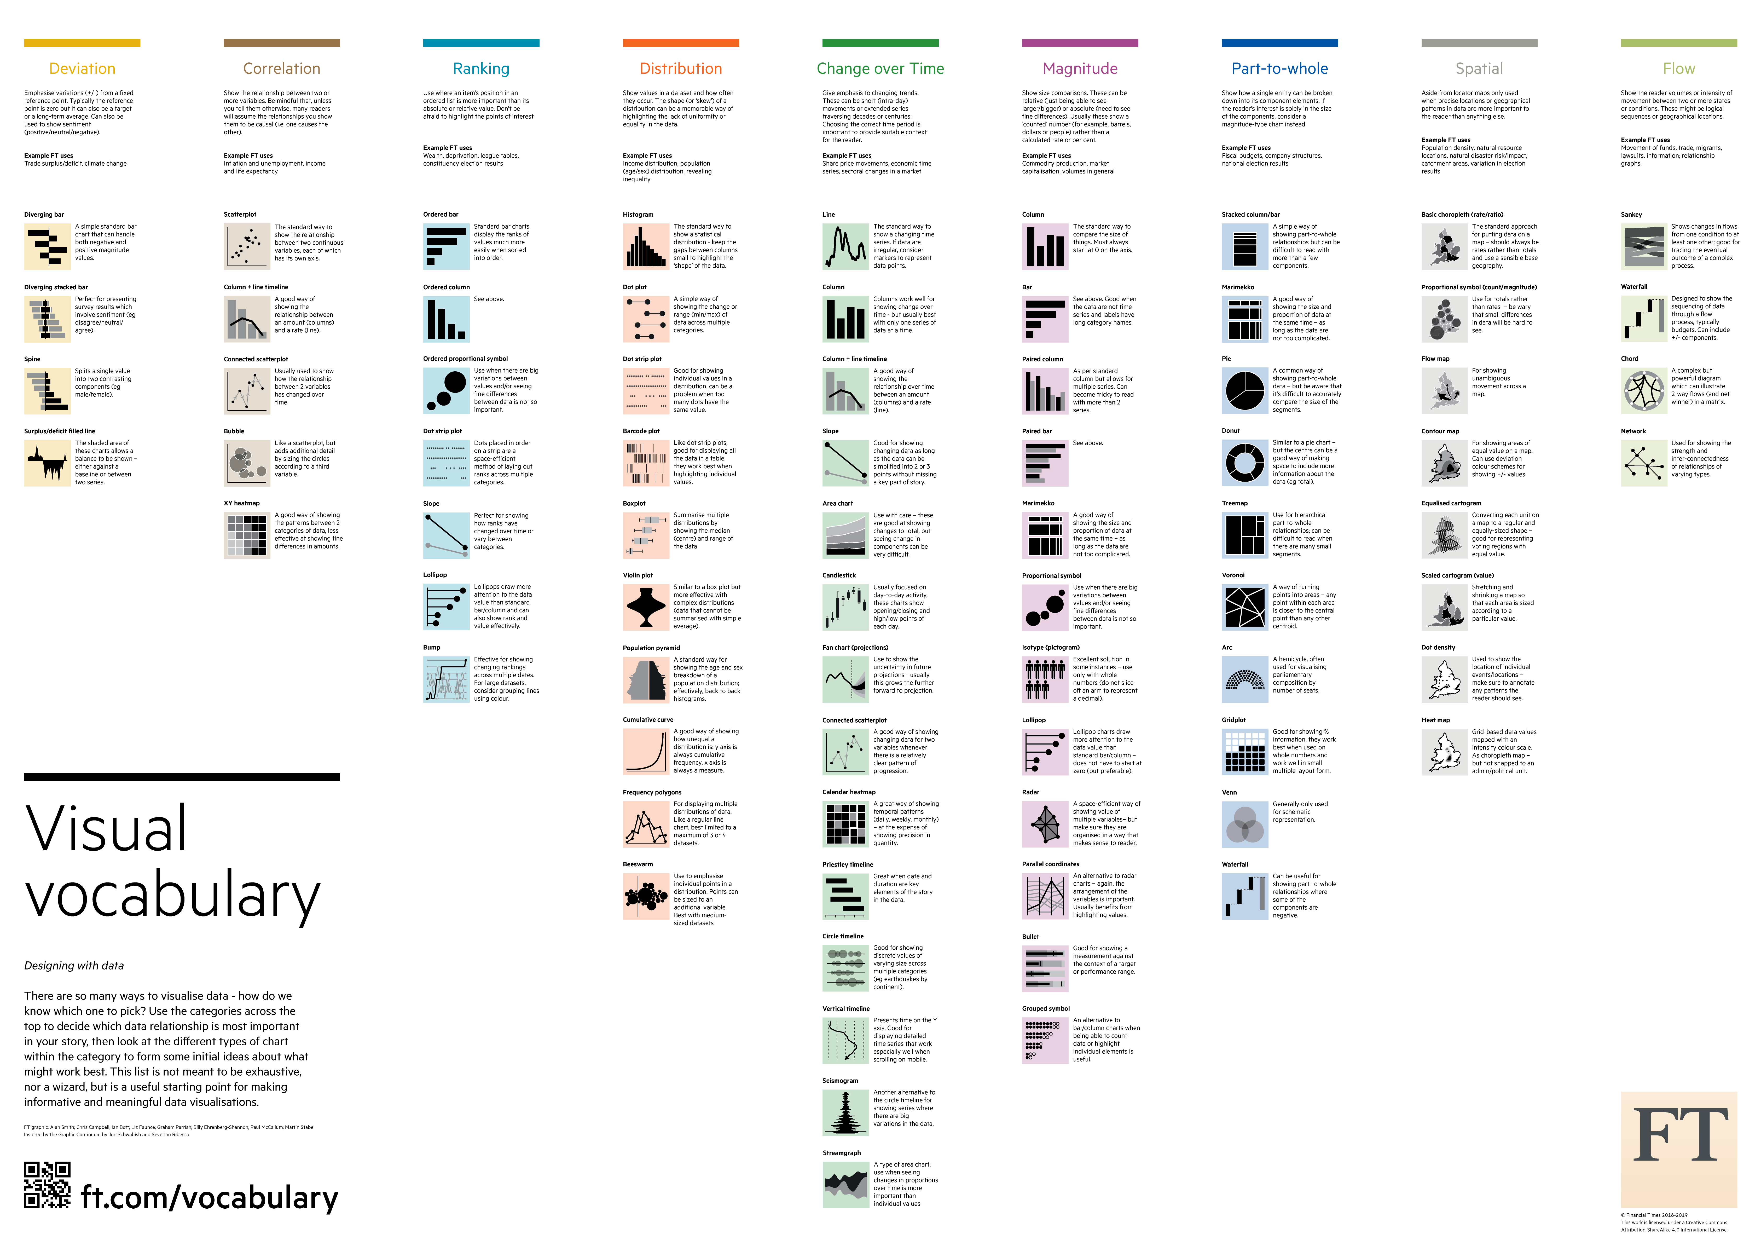
Technique and tasks
It isn’t just about the data, it’s also about the tasks
https://raw.githubusercontent.com/Financial-Times/chart-doctor/main/visual-vocabulary/poster.png

Slide 10
Part of a whole relationships

Slide 11
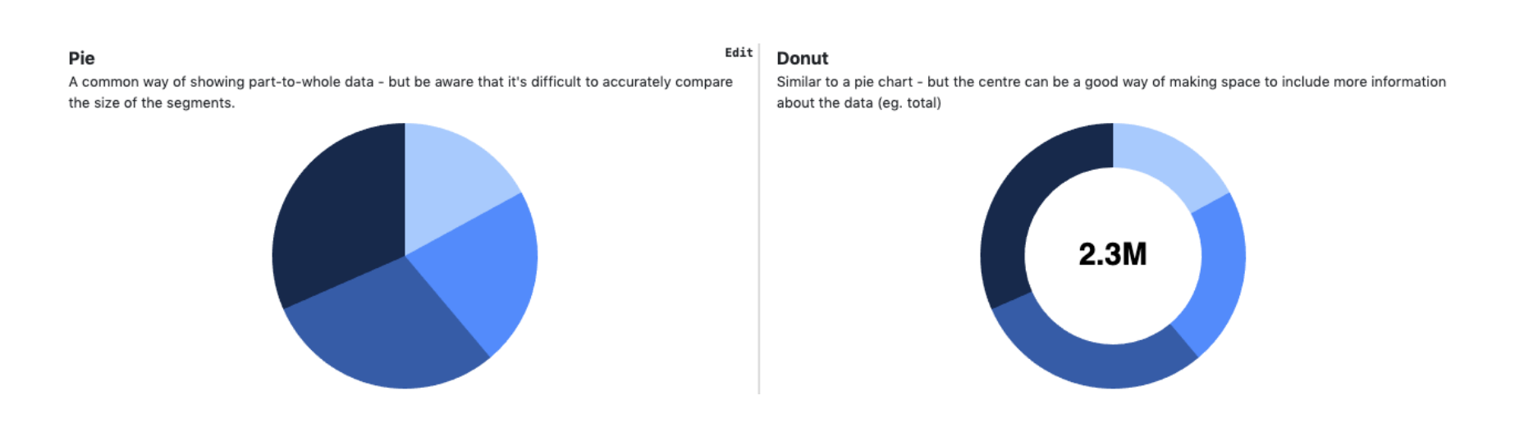
Pie and Donut Charts

Slide 12
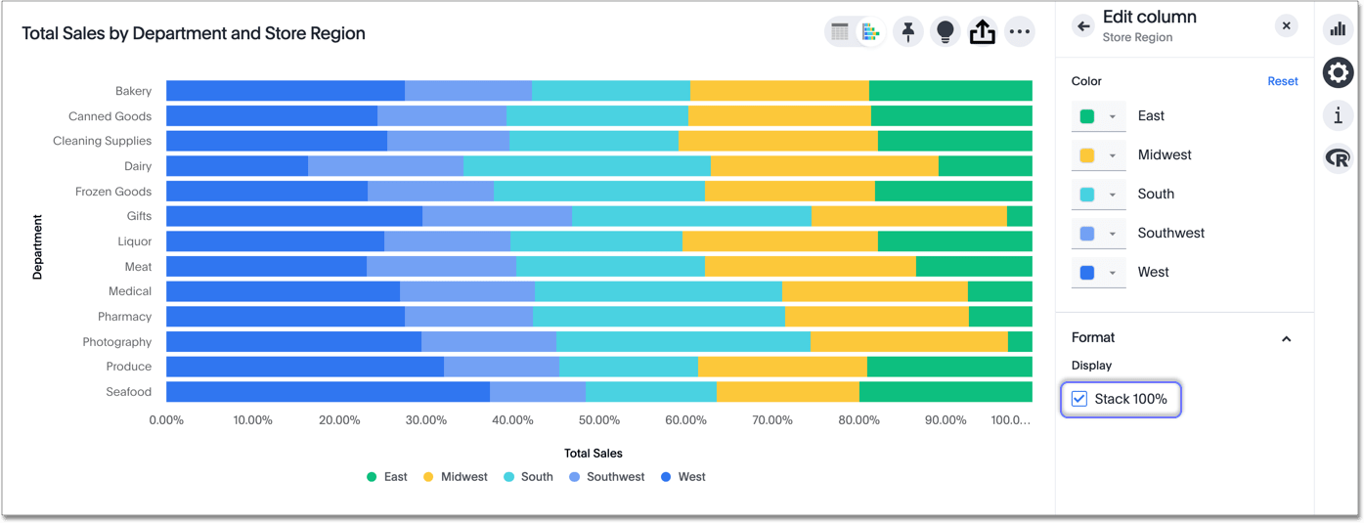
Comparing part-to-whole relationships: Percentages
Vs Pie chart- pro’s / con’s?

Slide 13
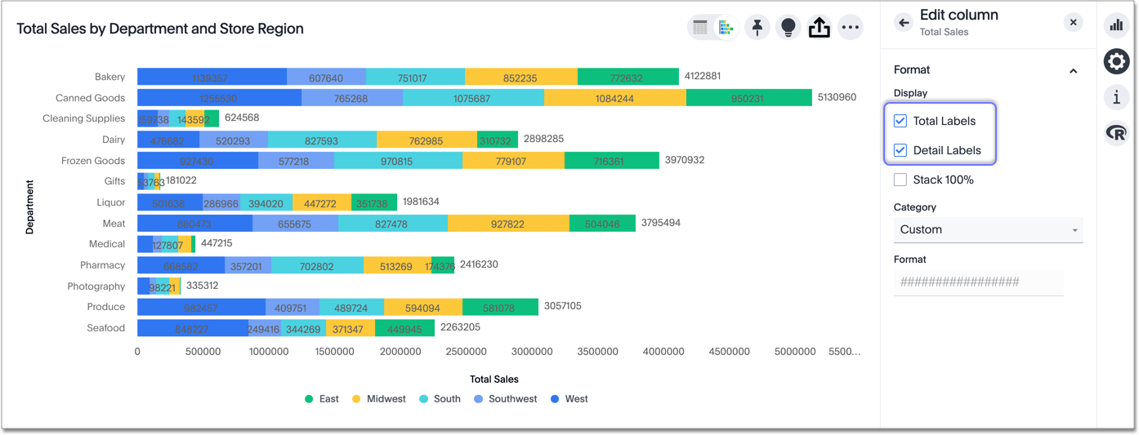
Comparing part-to-whole relationships: Stacked bar charts

Slide 14
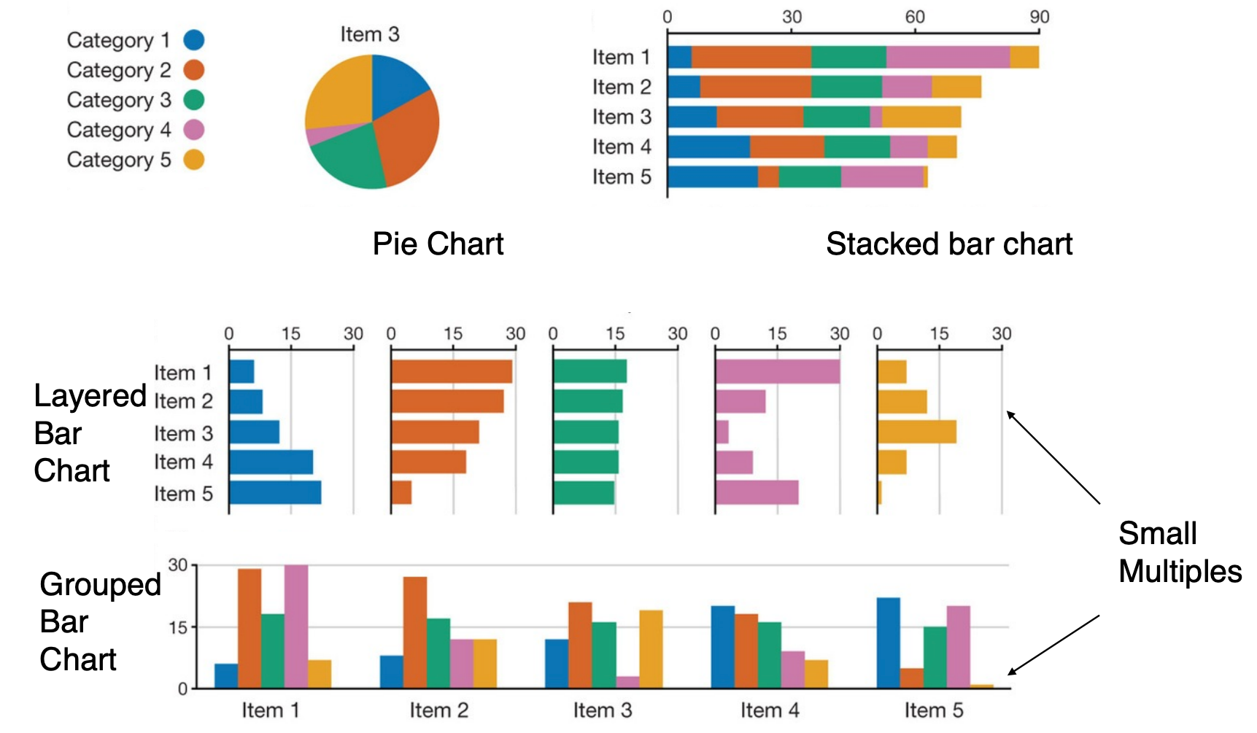
Comparing part-to-whole relationships
Streit Gehlenborg
POV Nature Methods 2014

Slide 15
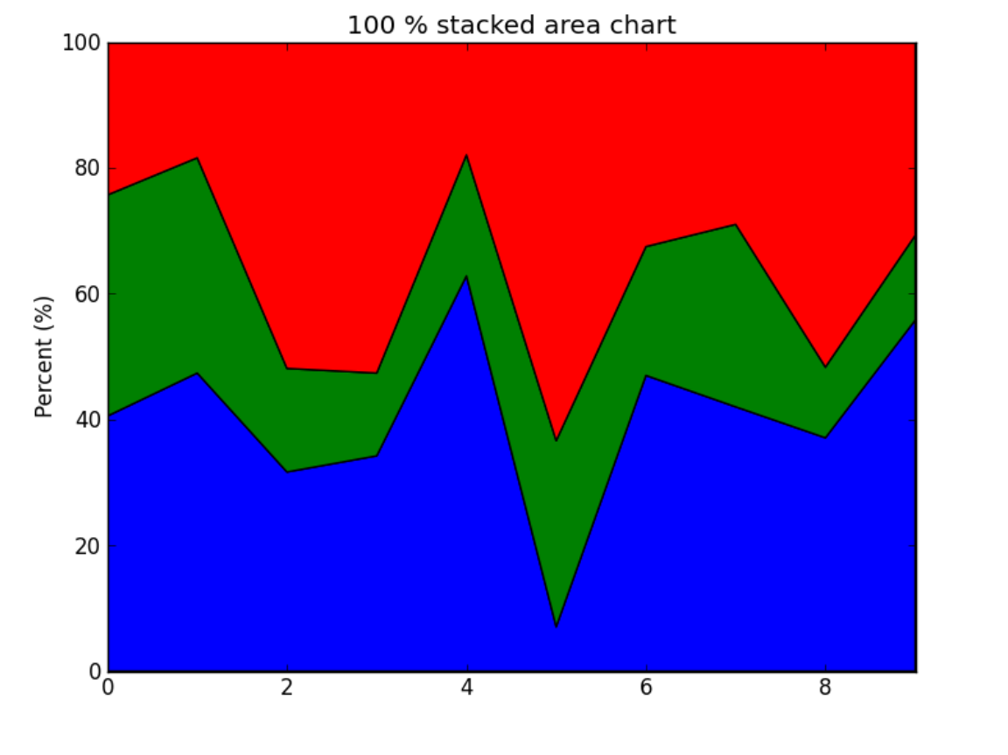
Part to whole relationships in time series
How well can we discern trends for each part?

Slide 16
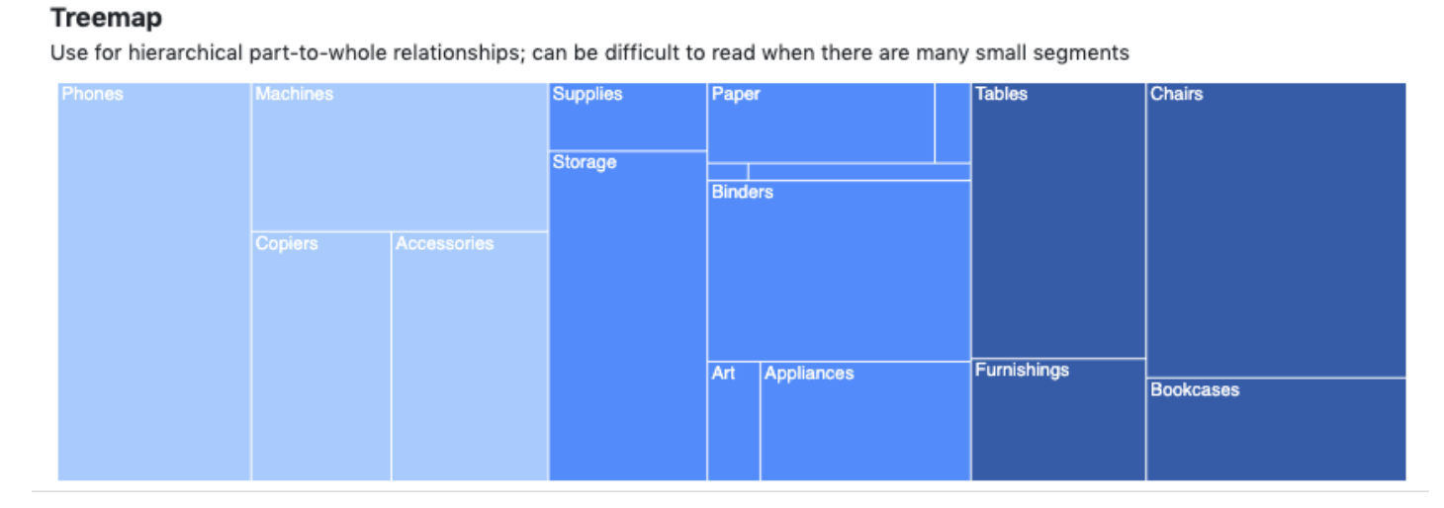
TreeMap- hierarchical part to whole

Slide 17
Distribution

Slide 18
Distributions
Aggregating large data vectors
Show distributions rather than all data points
Issues if data is not well behaved

Slide 19
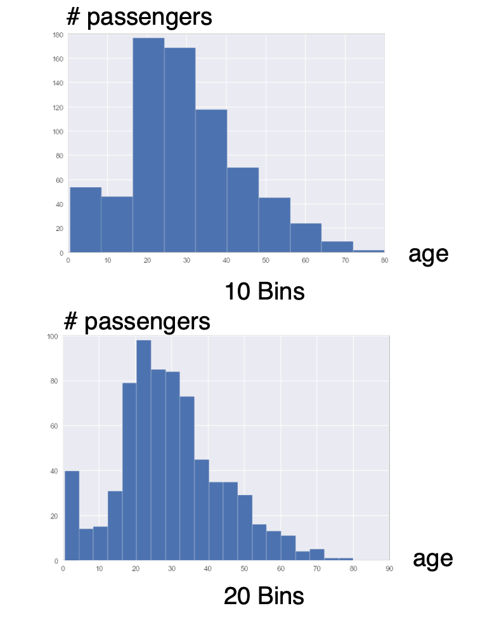
Histograms
Show a data vector in bins
How many items fall in each bin, based on its value

Slide 20
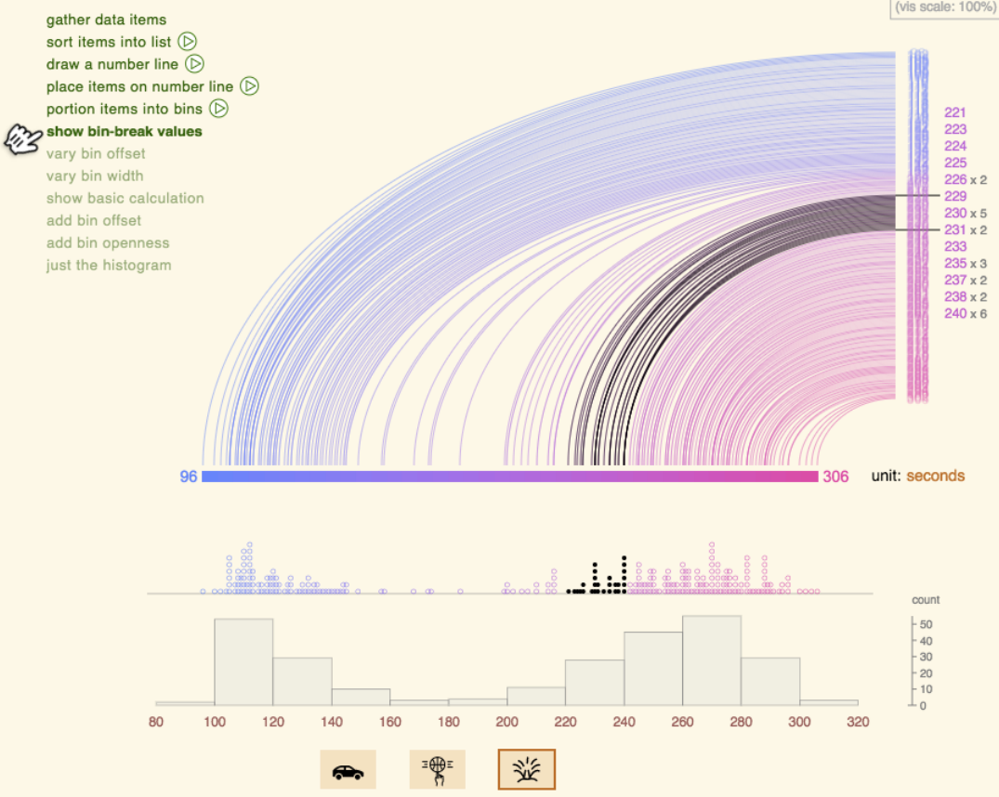
Illustrating histograms
http://tinlizzie.org/histograms/

Slide 21
Histograms
Good # of bins can be hard to predict
You can do this by allowing the users to interactively control
Rule of thumb: #bins = sqrt(n) , log2(n)+1`

Slide 22
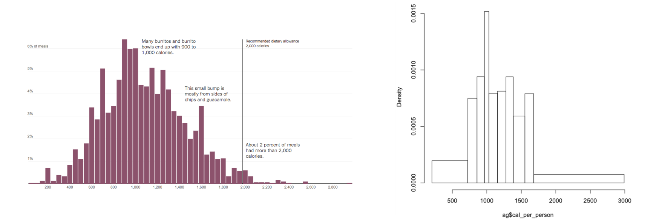
Unequal bin width?
Can be useful if data is very sparse in some areas
But tricky

Slide 23
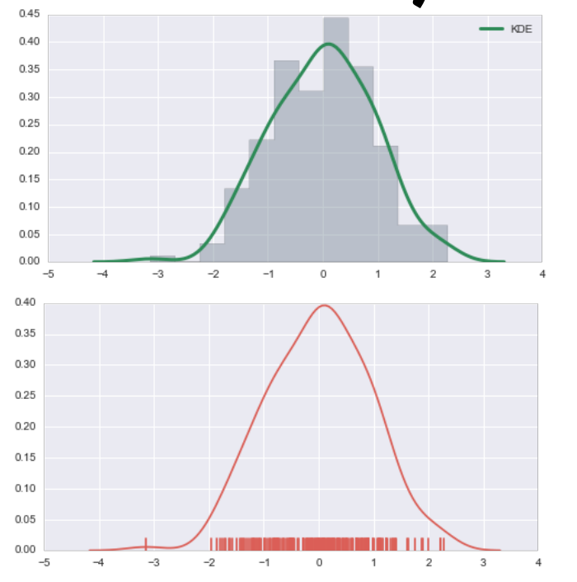
Kernel density estimation
You have a observations from a distribution
Want to estimate a curve for this distribution
Compute the parameters for that curve
https://mathisonian.github.io/kde/

Slide 24
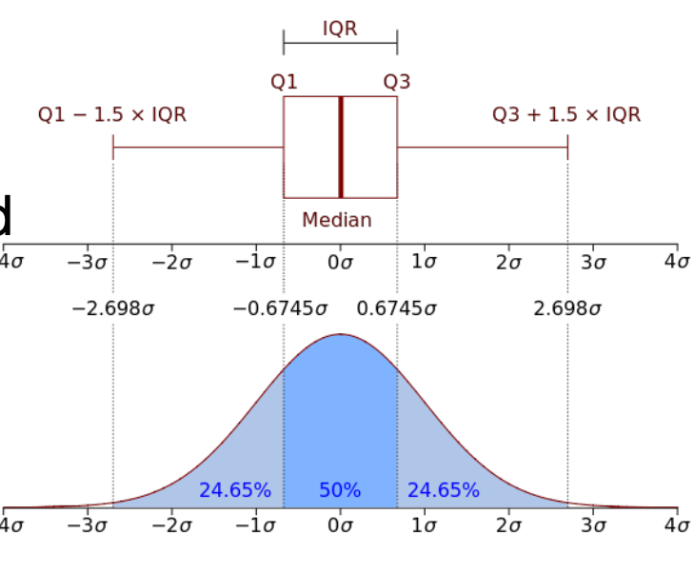
Box plots
Box and whiskers plot
Showing the median, and the quartiles- Q1-Q3
Show outliers as points
Bad for non-normal distributions
Bad for multi-modal distributions

Slide 25
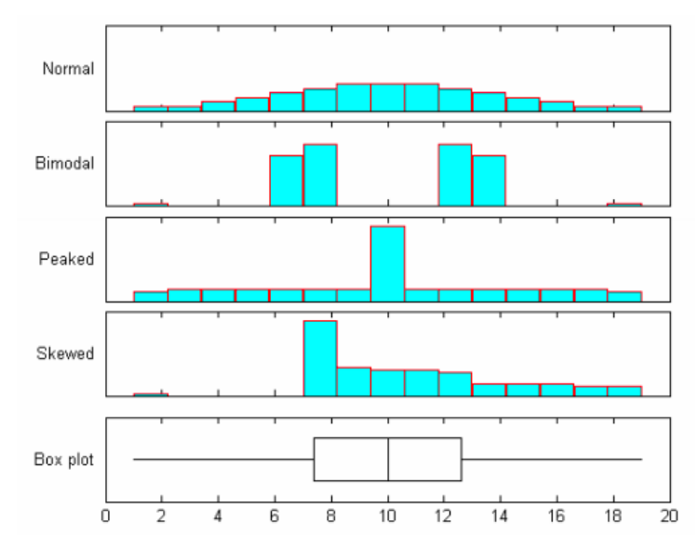
One box plot, four distributions
Lose information

Slide 26
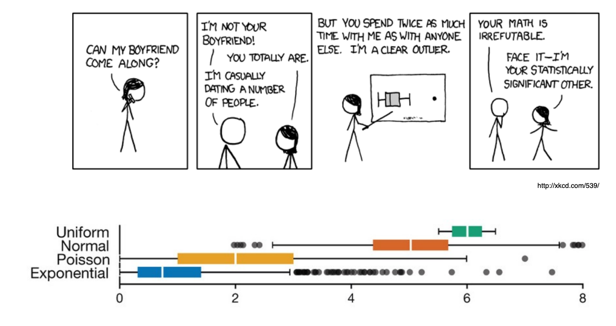
Plot the outliers in box and whiskers

Slide 27
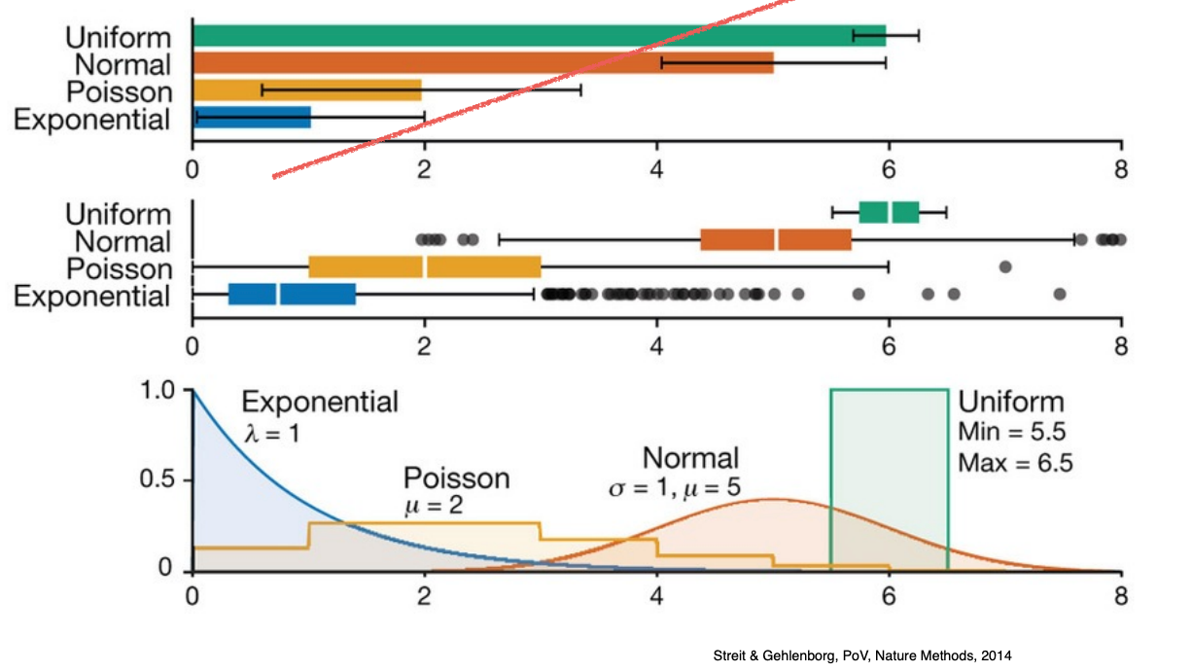
Different representations of the same distributions
Bar chart with error bars not great for distributions
Within the bar bias
Hiding the data
Box and whiskers
Ok for Uniform and normal distributions
Not great for others
Poisson: Losing the characteristic
Exponential: Lots of outliers
Plots on the bottom are preferred

Slide 28
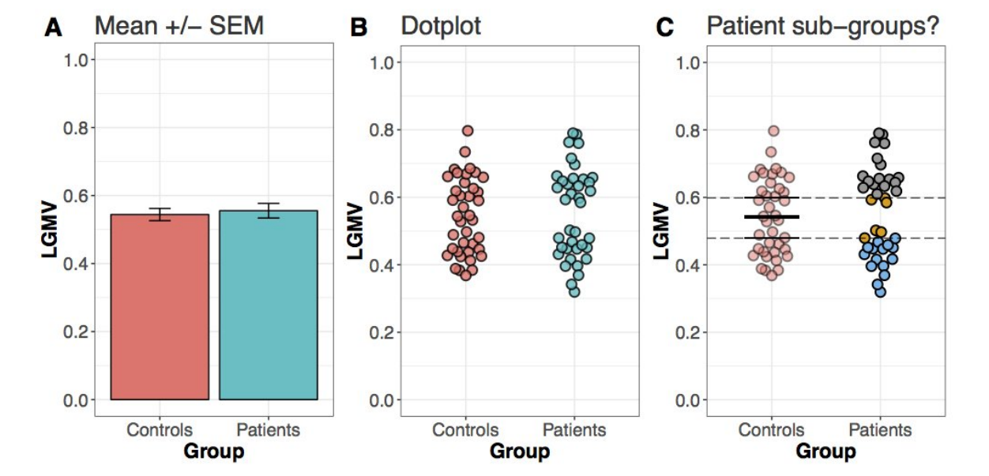
Box charts vs Dot Plots
Instead of box charts
Miss bimodal effects
Dot plots are a good alternative

Slide 29
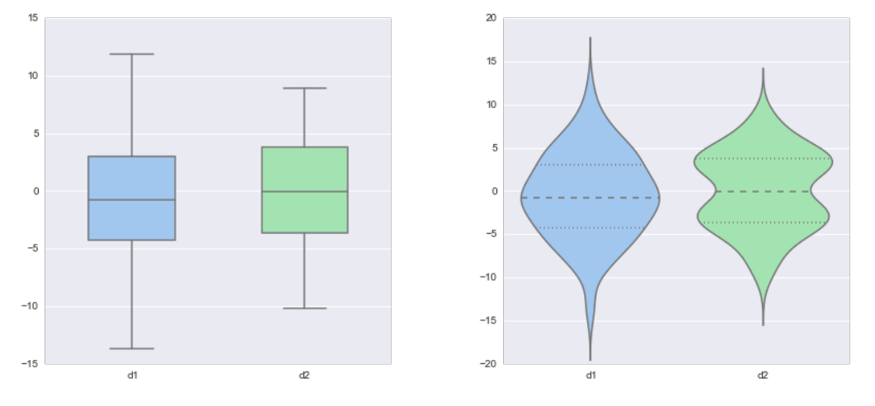
Violin plots- great alternative to a box plot
Can see more characteristics of the data
Box Plot + Probability density function

Slide 30
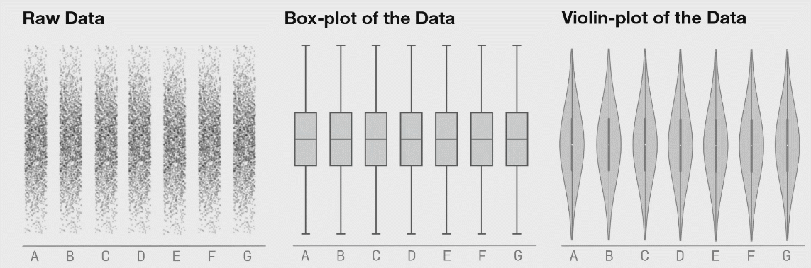
Different Distributions
https://blog.bioturing.com/2018/05/16/5-reasons-you-should-use-a-violin-graph/
Box plot doesn’t update, even when data changes significantly
Violin plot does update

Slide 31
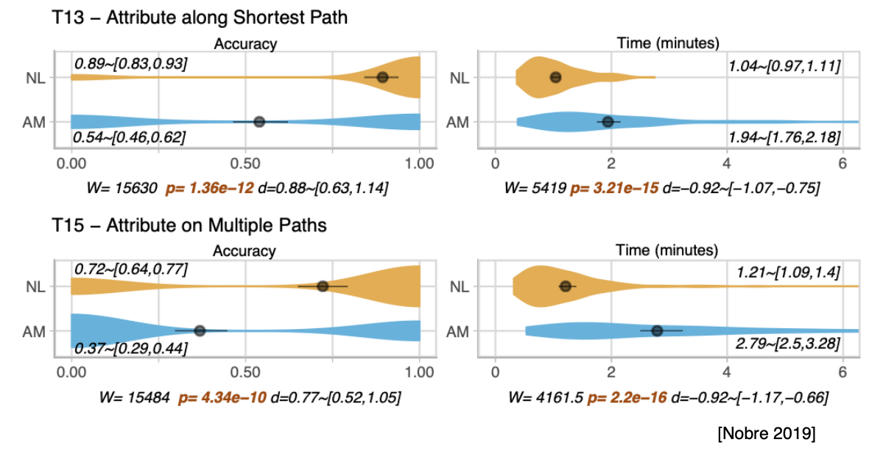
Example: How to visually report distributions for experiments
Two conditions- NL and AM
Encoded with color and positioning
A number of measures
Violin plots showing the distribution of the data
Mean is a circle
Confidence interval is with the line “whiskers:
Statistical measures represented too

Slide 32
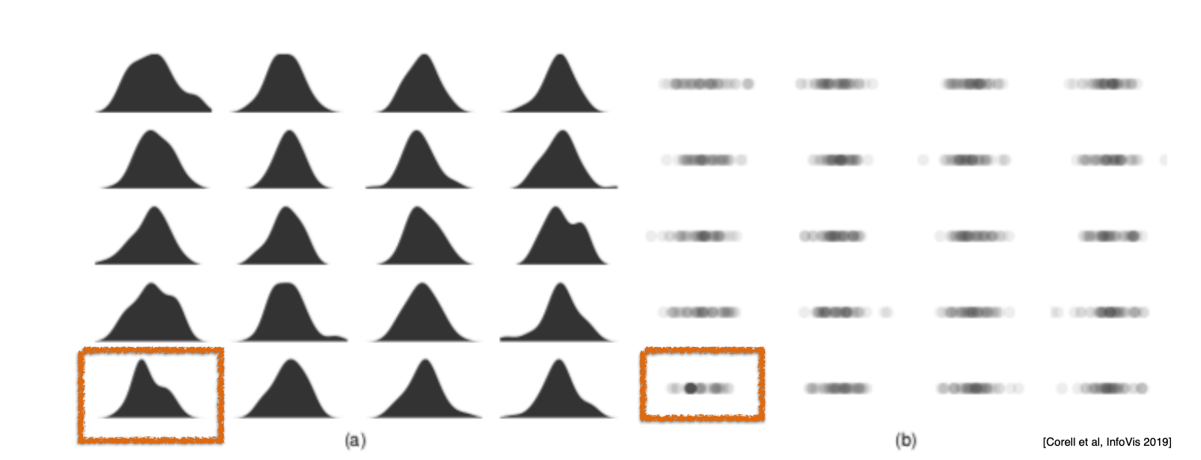
Compare
19 charts with randomly sampled data from a gaussian distribution
1 chart has 20% samples with identical values- which ones?

Slide 33
Compare
19 charts with randomly sampled data from a gaussian distribution
1 chart has 20% samples with identical values- which ones?

Slide 34
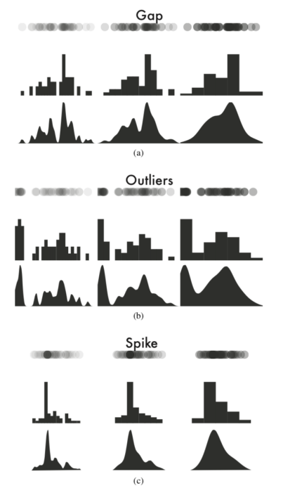
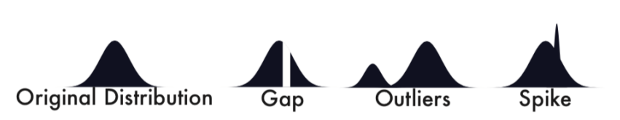
Detecting data flaws
Tricky to detect these flaws
If you are aggregating, binning…
Bin size, kernel type, bandwidth, vis choice impact how well people can detect these

Slide 35
Scale of Tables- impacts the vis approach
Need different approaches for normal vs high dimensional tables
How many dimensions
50- possible with just vis
>1000 need analytical methods (dimensionality reduction)

Slide 36
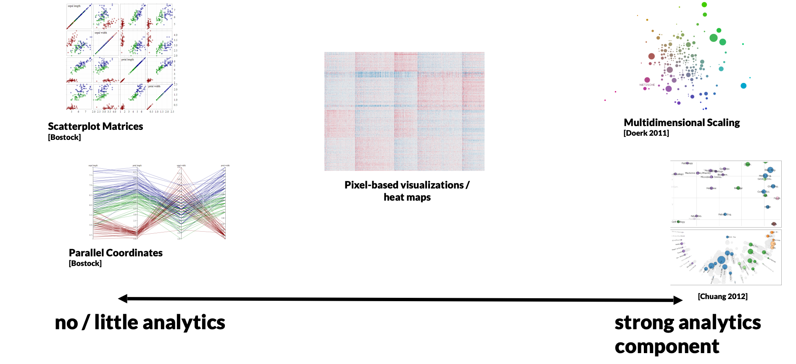
High Dimensional data—> may require dimensionality reduction, scaling methods

Slide 37
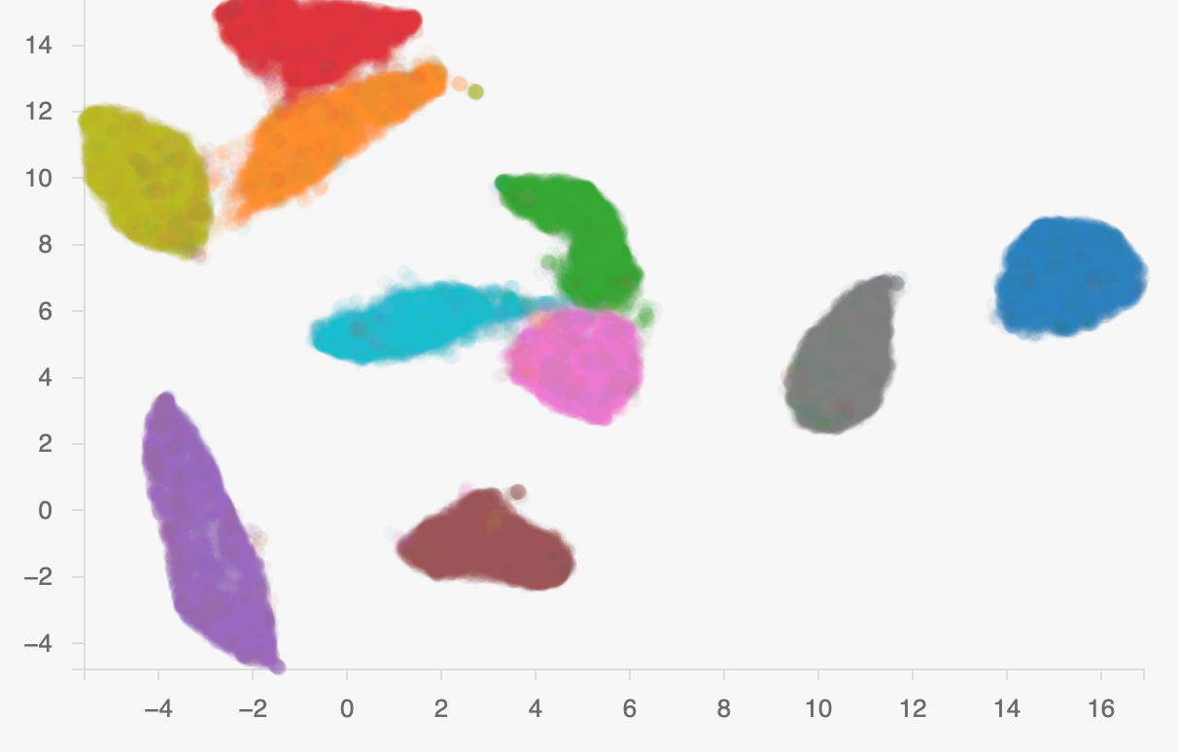
High-dimensional tables
Dimensionality reduction
Transform tables with quantitative data (high-dimensional space)
Into 3 or 2 dimensions (splat into a form you can view)
Goal: preserve clusters/neighbors
Principle Component Analysis (PCA)
T-SNE
UMAP

Slide 38
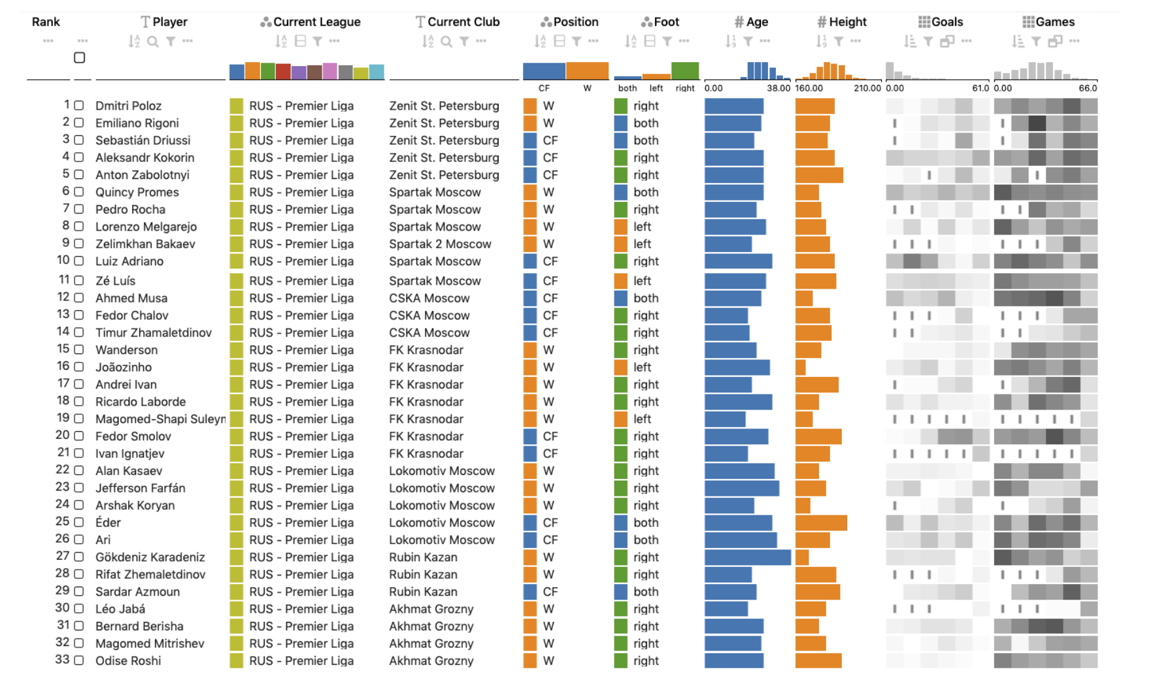
Visual tables- charts within the table
Alex Lex et al.

Slide 39
Technique and tasks
It isn’t just about the data, it’s also about the tasks
https://raw.githubusercontent.com/Financial-Times/chart-doctor/main/visual-vocabulary/poster.png

Slide 40
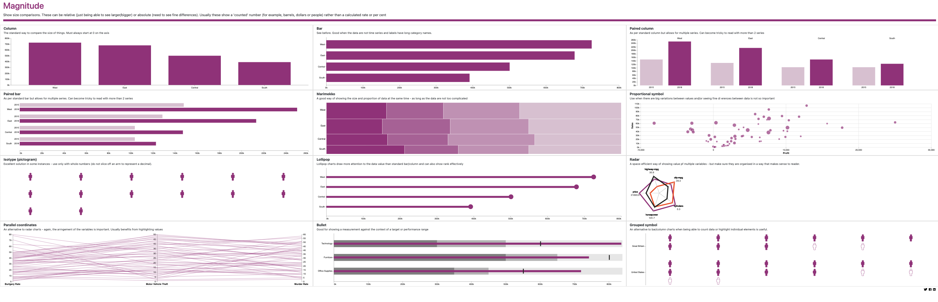
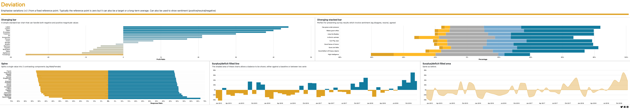
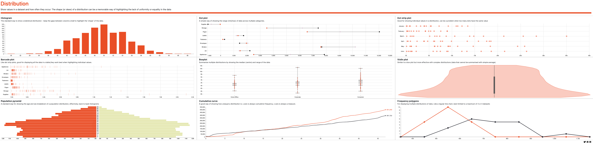
Technique and tasks
It isn’t just about the data, it’s also about the tasks
https://gramener.github.io/visual-vocabulary-vega/#/Distribution/

Slide 41
Activity….

